Slide 1
Implementing Machine Learning Techniques To Forecast Floods In Bangladesh Based On Historical Data
by
S.M Toufique
19201141
Computer Science and Engineering
BRAC University
Dhaka, Bangladesh
s.m.toufique@g.bracu.ac.bd
Sadiq Uddin Bhuiyan
19201018
Computer Science and Engineering
BRAC University
Dhaka, Bangladesh
sadiq.uddin.bhuiyan@g.bracu.ac.bd
Ahmed Lateef
19241016
Computer Science and Engineering
BRAC University
Dhaka, Bangladesh
ahmed.lateef@g.bracu.ac.bd
Arman Zaman
19201005
Computer Science and Engineering
BRAC University
Dhaka, Bangladesh
arman.zaman@g.bracu.ac.bd
Jubaer Bin Islam
19341002
Computer Science and Engineering
BRAC University
Dhaka, Bangladesh
jubaer.bin.islam@g.bracu.ac.bd
Dewan Ziaul Karim
Supervisor
Computer Science and Engineering
BRAC University
Dhaka, Bangladesh
ziaul.karim@bracu.ac.bd

Slide 2
TABLE OF CONTENTS
1. Background Information
2. Related Works
3. Workflow
4. Dataset Description
5. Data Preprocessing
6. Classification
7. Experimental Setup
8. Performance Analysis
9. AUC-ROC Graphs
10. Confusion Matrix
11. Final Discussion and Future Works

Slide 3
BACKGROUND INFORMATION
Monsoon Season in South Asia: Heavy rains and floods, with 70% of annual rainfall between June and October.
Impact on Bangladesh and India: In 2020, 83% of Sylhet and 90% of Sunamganj submerged, affecting 6 million people.
Flood-Related Damage: Over 1 million homes destroyed, 41 deaths, extensive damage to agriculture, fisheries, and infrastructure.
Economic Impact: Loss of $42 million in crops, 83000 hectares of paddy fields, and $74.5 million in livestock.
Challenges in Flood Prediction: Limitations of traditional models, leading to the exploration of machine learning for enhanced accuracy.
Climate Change Effects: Rising sea levels and changing rainfall patterns exacerbate flood risks, demanding more effective prediction methods.
Technological Advances: Development of sophisticated satellite and radar systems for better monitoring and prediction of flood patterns.

Slide 4
Motivation
In 2020, unprecedented monsoon rains triggered catastrophic floods in Bangladesh, affecting over 5 million people and displacing millions from their homes. The devastating scenario resulted in a staggering economic loss exceeding $2 billion,
In 2023, heavy monsoon rains led to severe flooding in Pakistan, impacting millions and causing a humanitarian crisis. The statistics paint a grim picture, with hundreds of lives lost, thousands displaced, and economic losses reaching alarming figures
Bangladesh's flood management primarily relies on reactive measures, responding to floods as they occur rather than proactively predicting and preparing for them.
This reactive approach often leads to delayed emergency responses, hindering the effectiveness of relief efforts and exacerbating the impact on affected communities.
By harnessing the historical data of weather patterns, rainfall, and flood occurrences, we aim to breathe new life into information gathering dust for years.
Our innovative approach transforms this dormant data into a valuable resource, leveraging the power of machine learning to extract hidden insights crucial for accurate flood prediction.
Our aim is to break away from reactive flood management with this model, we anticipate predicting, with meaningful accuracy, whether a region is at risk of flooding, allowing for timely and targeted preparedness measures to minimize the impact on communities.

Slide 5
RELATED WORKS
Artificial neural networks technology : ANN (Artificial Neural Networks)
River flood forecasting with a neural network model Feed : Forward Neural Network
Improved flood susceptibility mapping using a best first decision tree integrated with ensemble learning techniques : Decision Tree Algorithms
Typhoon flood forecasting using integrated two-stage support vector machine approach : Support Vector Machine (SVM)
Evaluation of flood susceptibility mapping using logistic regression and gis conditioning factors : Logistic Regression
Improved k-nearest neighbor weather generating model : K-Nearest Neighbor (K-NN)
Flood detection using gradient boost machine learning approach : Gradient Boost Algorithm

Slide 6
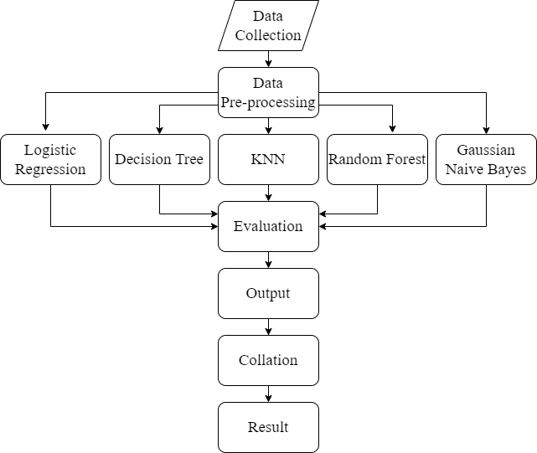
WORKFLOW

Slide 7
DATASET DESCRIPTION
Dataset ~ weather data from multiple weather observation stations across Bangladesh since 1990
200,000 data points, various weather parameters
Collected from Bangladesh Meteorological Department (BMD) and Bangladesh Water Development Board (BWDB)
Features included rainfall, humidity, maximum, minimum and average temperature, wind speed and direction, cloud amount, maximum, minimum and average water level, danger level, date and a binary flood value
Water level exceeding danger level would cause a flood
Danger Level:
of rivers with no embankment - same as annual average flood level
of rivers with embankment - fixed slightly below design flood level
Binary value of 1 indicating a flood and 0 for no flood
Random sampling across four basins ~ Brahmaputra, Ganges, Meghna and South East Hill Basin.
Consisted of 219,602 rows in total - Brahmaputra with the highest of 86,004 rows, South East Hill with 60,858 rows, Ganges and Meghna close with 36,828 and 35,912 rows respectively.

Slide 8
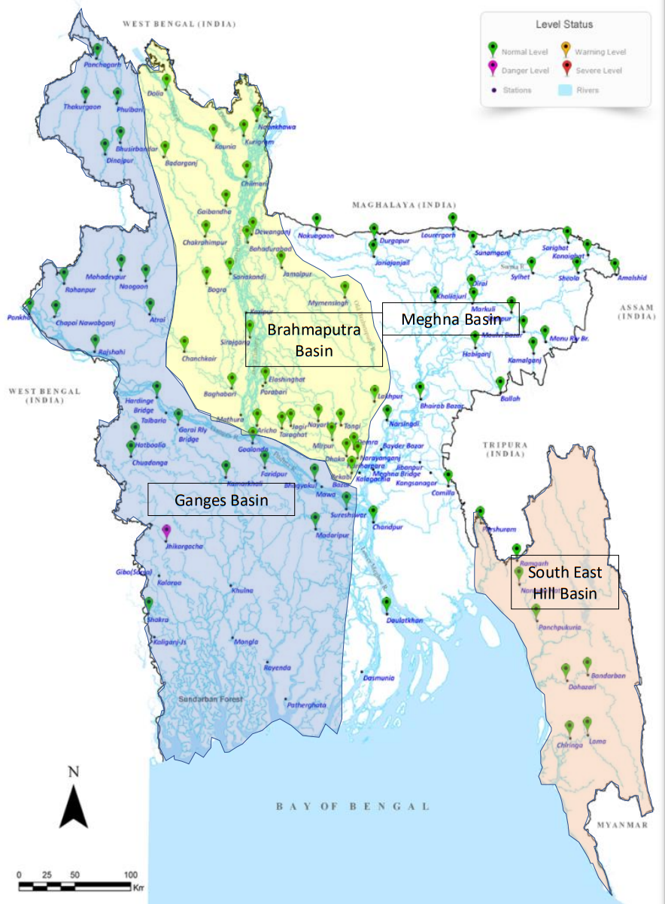
Fig: Basin Map of Bangladesh with water-level gauge stations

Slide 9
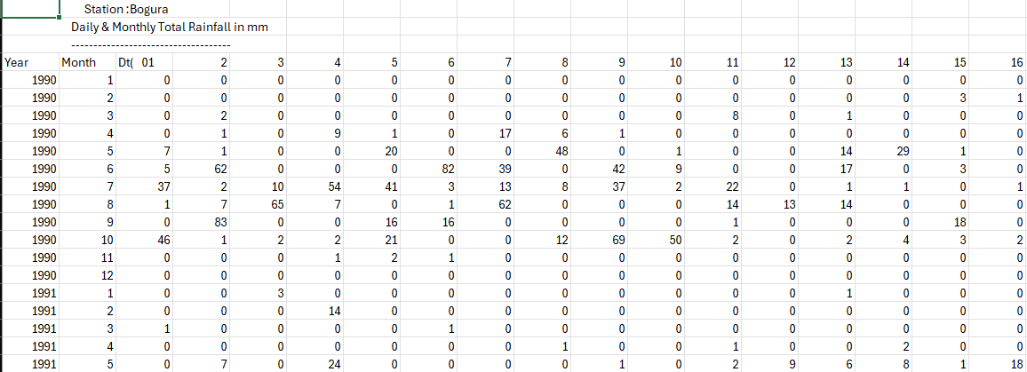
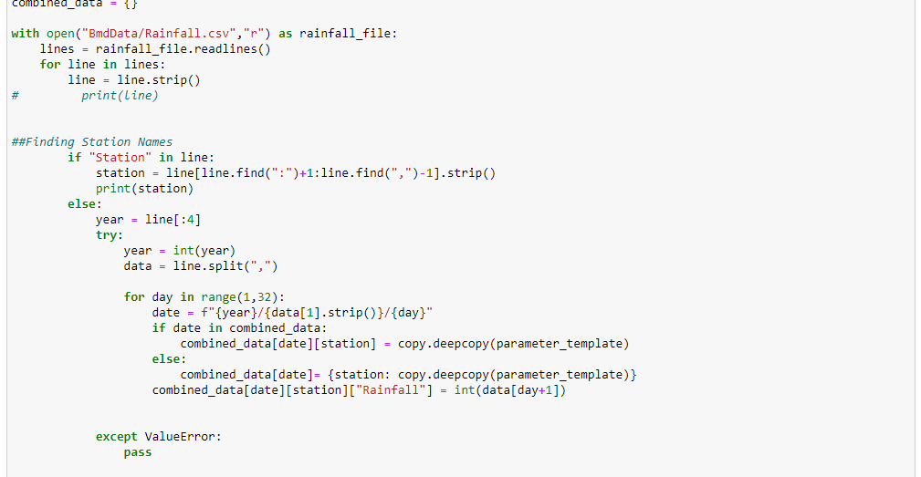
DATASET PRE-PROCESSING
Parsing Data
The dataset received from BMD was 8 files for each of the parameters
The dataset received from BWDB was 11 files for each of the stations
Each file was distinctly formatted by the respective organization
Each file was parsed to extract data by station and date
The nested list is used to combine the data
Final Dataset is created upon parsing all files

Slide 10
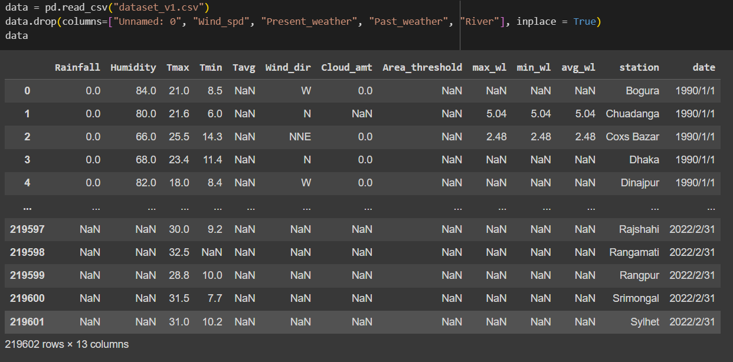
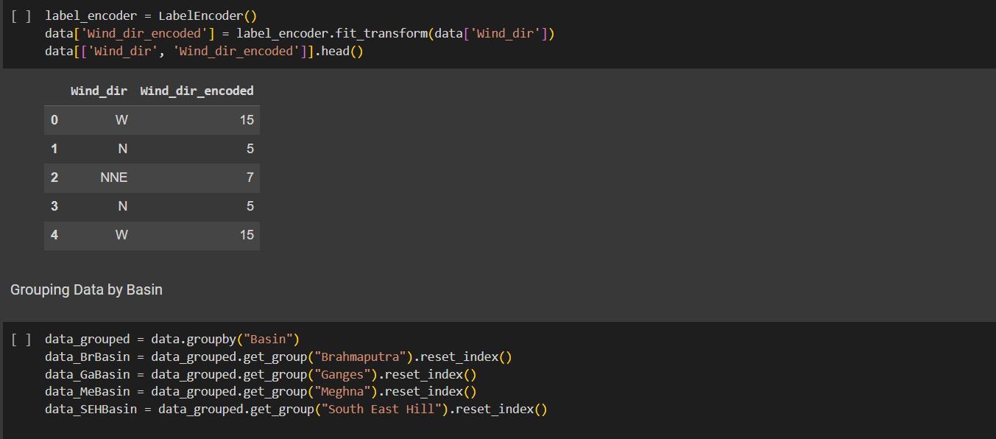
DATASET PRE-PROCESSING
Classifying Dataset
Dataset divided according to the four basins
Imputing Values
Missing values filled with mean values using Simple Imputer
Cleaning Data
Parameters not relevant for ML models removed
Adding Danger-level for each station and flood flagging
Encoding data
Categorical string data encoded using label encoder
Train Test Split
The dataset was split into 2 portions, train 75% and test 25% with stratification

Slide 11
METHODOLOGY
Dataset and Classifiers ~ Weather data from multiple stations across Bangladesh since 1990. Classifiers chosen for:Handling linear and nonlinear relationships, Handling categorical and continuous features Balancing interpretability and accuracy.
Five machine learning classifiers:
Logistic Regression
A binary classification model that predicts the probability of flood occurrence based on weather parameters. Provides interpretable coefficients that indicate the influence of each predictor on flood likelihood.
Decision Tree
A non-parametric model that splits the data into subsets based on if-else rules derived from the predictors. Captures complex and nonlinear relationships among the variables and provides an intuitive structure for flood prediction.
K-Nearest Neighbor
A distance-based model that assigns a class label to a new data point based on the majority vote of its k closest neighbors in the feature space. Adapts well to different data distributions and leverages the similarity between data points for flood prediction.
Random Forest
An ensemble model that combines multiple decision trees and aggregates their predictions by averaging or majority voting. Reduces the variance and overfitting of individual trees and improves the accuracy and robustness of flood prediction.
Gaussian Naive Bayes
A probabilistic model that applies Bayes’ theorem and assumes conditional independence among the predictors given the class label. Performs well with continuous features and provides probabilistic predictions for flood occurrence

Slide 12
RESULTS AND ANALYSIS
Decision Tree Classifier | Accuracy (%) | Recall (%) | Precision (%) | F1-Score (%) | Error (%)
Brahmaputra Basin | 78.5 | 80.0 | 81.7 | 80.84 | 21.5
Ganges Basin | 97.7 | 37.4 | 41.7 | 39.43 | 2.3
Meghna Basin | 100 | 100 | 100 | 100 | 0
South East Hill Basin | 96.2 | 74.4 | 77.2 | 75.77 | 3.8
Entire Dataset | 82.9 | 87.5 | 87.4 | 87.4 | 17.1
Table: Performance Comparison of the Basins Employing Decision Tree Classifier

Slide 13
RESULTS AND ANALYSIS
KNN | Accuracy (%) | Recall (%) | Precision (%) | F1-Score (%) | Error (%)
Brahmaputra Basin | 78.2 | 80.0 | 81.3 | 80.64 | 21.8
Ganges Basin | 97.4 | 40.7 | 36.3 | 38.37 | 2.6
Meghna Basin | 99.3 | 87.0 | 92.3 | 89.57 | 0.7
South East Hill Basin | 92.9 | 53.1 | 55.3 | 54.18 | 7.1
Entire Dataset | 80.9 | 86.2 | 85.8 | 86.0 | 19.1
Table: Performance Comparison of the Basins Employing KNN

Slide 14
RESULTS AND ANALYSIS
Logistic Regression | Accuracy (%) | Recall (%) | Precision (%) | F1-Score (%) | Error (%)
Brahmaputra Basin | 82.6 | 97.9 | 77.4 | 86.5 | 17.4
Ganges Basin | 98.0 | Undefined | Undefined | Undefined | 2.0
Meghna Basin | 99.0 | 80.4 | 87.7 | 83.9 | 1.0
South East Hill Basin | 92.0 | 0.01 | 33.3 | 0.02 | 8.0
Entire Dataset | 69.3 | 94.1 | 70.6 | 80.7 | 30.7
Table: Performance Comparison of the Basins Employing Logistic Regression

Slide 15
RESULTS AND ANALYSIS
Gaussian Naive Bayes | Accuracy (%) | Recall (%) | Precision (%) | F1-Score (%) | Error (%)
Brahmaputra Basin | 80.1 | 89.5 | 78.5 | 83.8 | 19.9
Ganges Basin | 90.1 | 69.2 | 12.9 | 21.7 | 9.9
Meghna Basin | 95.7 | 91.4 | 43.6 | 59.0 | 4.3
South East Hill Basin | 85.9 | 19.4 | 16.7 | 17.9 | 14.1
Entire Dataset | 69.2 | 93.1 | 70.8 | 80.4 | 30.8
Table: Performance Comparison of the Basins Employing Gaussian Naive Bayes

Slide 16
RESULTS AND ANALYSIS
Random Forest | Accuracy (%) | Recall (%) | Precision (%) | F1-Score (%) | Error (%)
Brahmaputra Basin | 83.1 | 90.7 | 81.6 | 85.9 | 16.9
Ganges Basin | 98.3 | 32.4 | 62.8 | 42.7 | 1.7
Meghna Basin | 100 | 100 | 100 | 100 | 0.0
South East Hill Basin | 97.1 | 74.8 | 87.3 | 80.6 | 2.9
Entire Dataset | 85.6 | 87.9 | 90.6 | 89.3 | 3 14
Table: Performance Comparison of the Basins Employing Random Forest

Slide 17
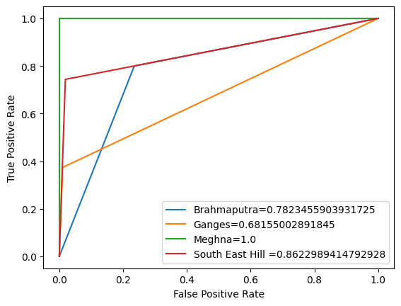
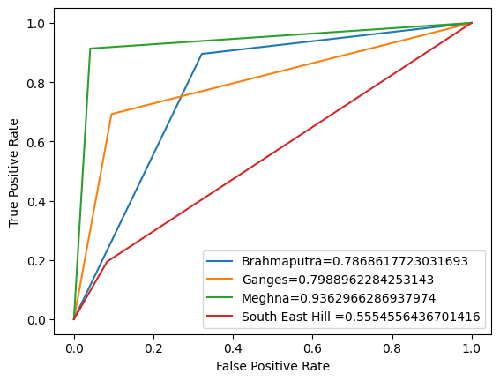
AUC-ROC Graphs
Fig: Decision Tree Classifier
Fig: Gaussian Naive Bayes

Slide 18
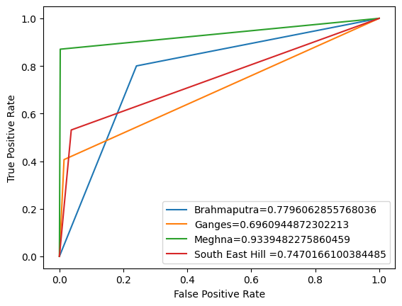
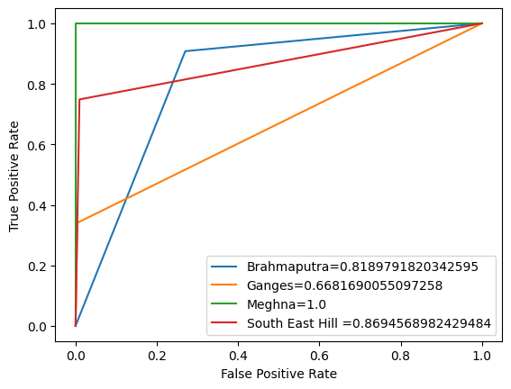
AUC-ROC Graphs
Fig: K-Nearest Neighbor
Fig: Random Forest

Slide 19
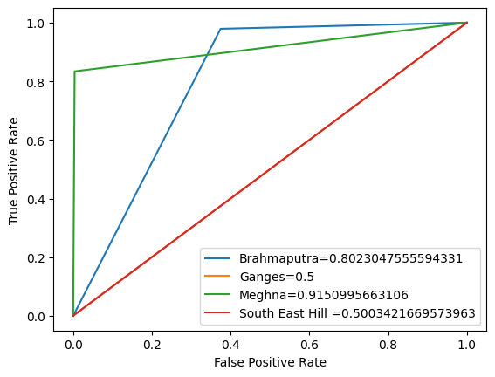
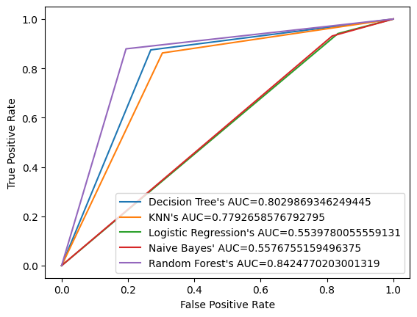
AUC-ROC Graphs
Fig: Logistic Regression
Fig: Full Dataset

Slide 20
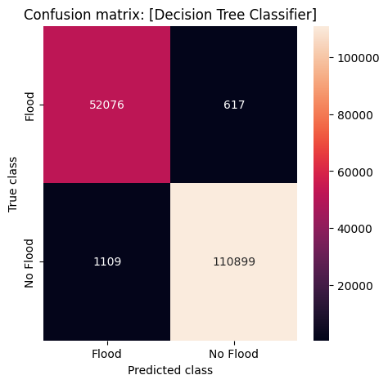
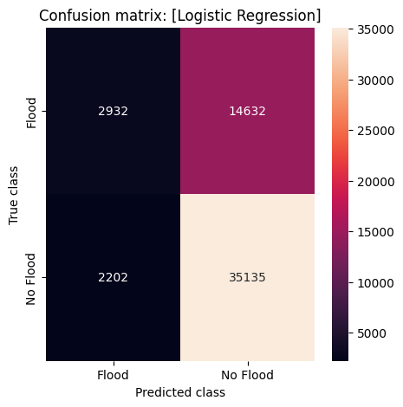
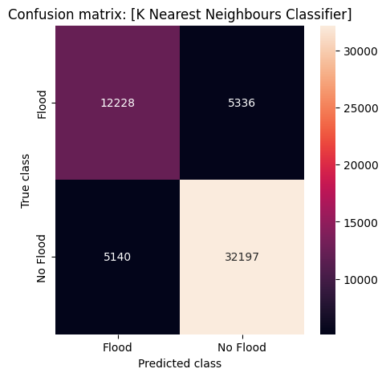
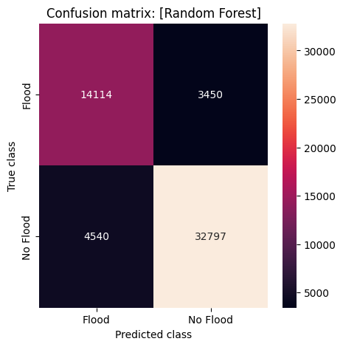
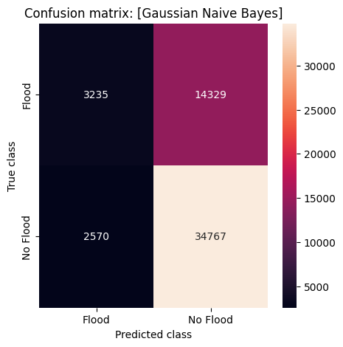
CONFUSION MATRIX OF ENTIRE DATASET

Slide 21
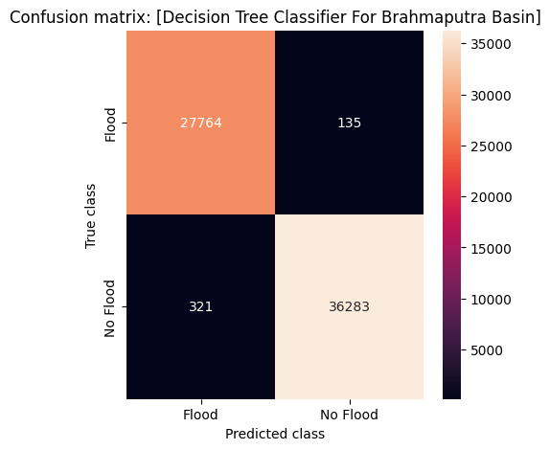
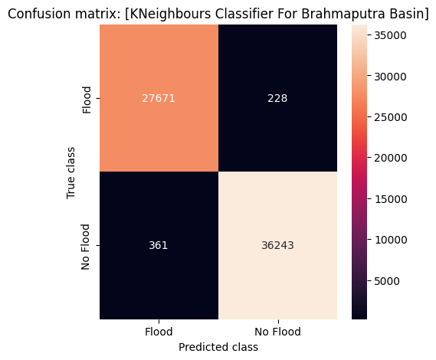
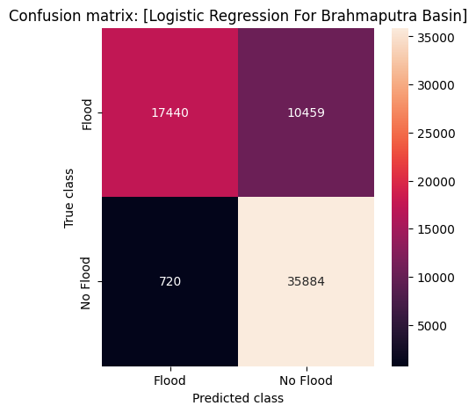
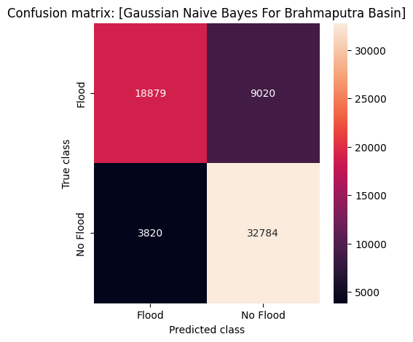
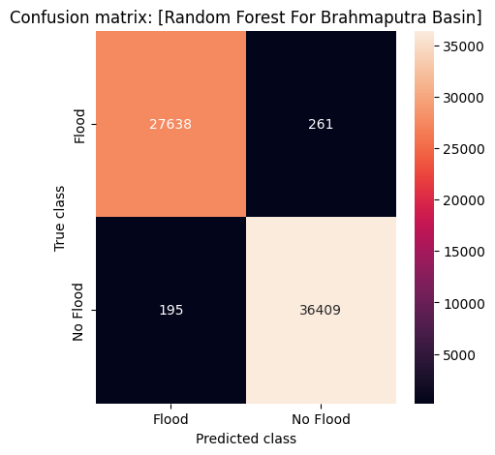
CONFUSION MATRIX OF BRAHMAPUTRA DATASET

Slide 22
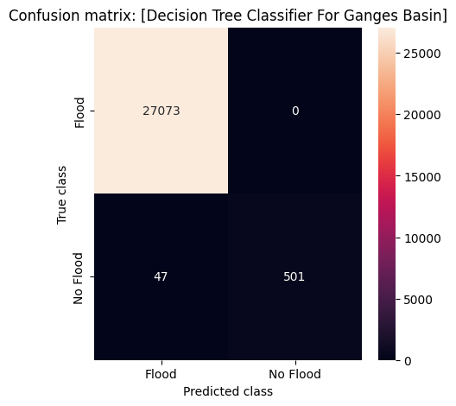

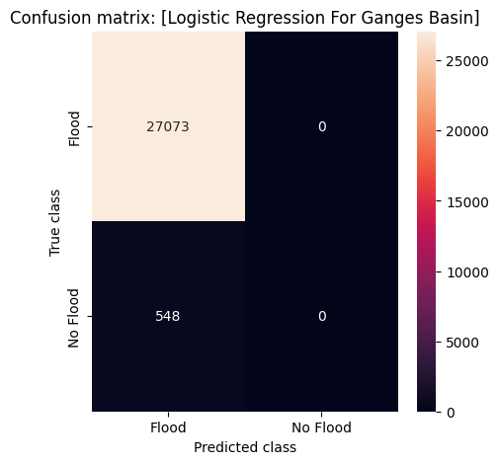
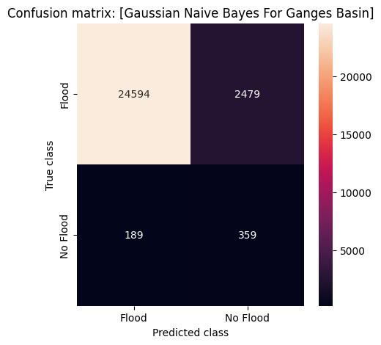
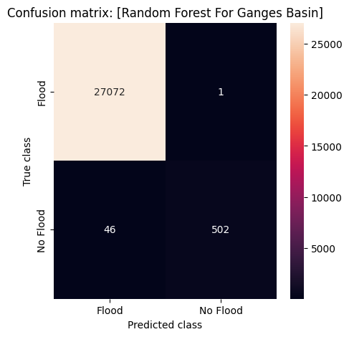
CONFUSION MATRIX OF GANGES DATASET

Slide 23




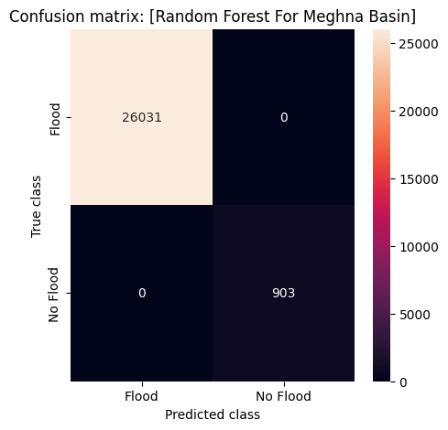
CONFUSION MATRIX OF MEGHNA DATASET

Slide 24
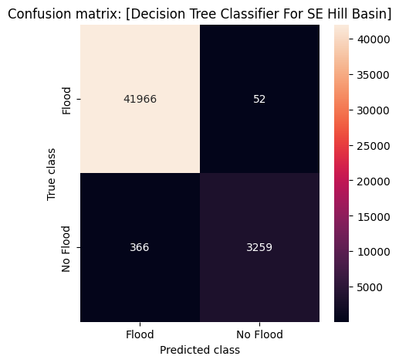
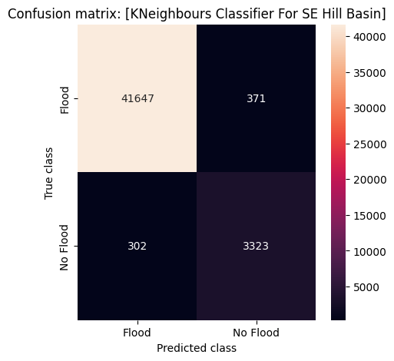
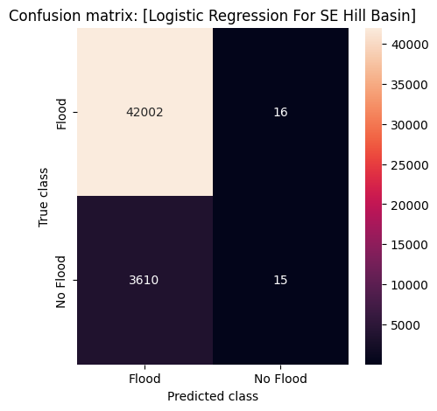
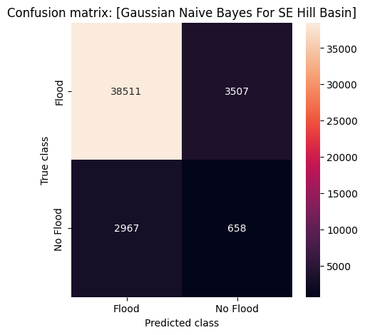
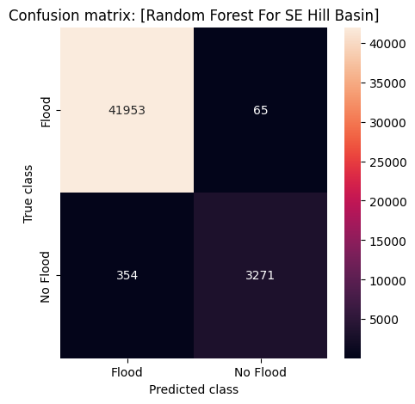
CONFUSION MATRIX OF S.E.H. DATASET

Slide 25
FINAL DISCUSSION
By running the ML algorithms on the full national dataset and the 4 flood basin datasets, we can use the full dataset as a control for comparing the efficacy of different the different algorithms.
Dividing the dataset into the 4 basins also reduces the noise in the dataset as grouping by geography lessens the effect of distant locations on each other.
The Meghna River basin dataset was overfitted for the majority of algorithms; mainly due to the lack of data entries and the small number of weather stations located in the river basin.
The Naive Bayes algorithm proved to be somewhat resistant to overfitting as it made false predictions that fall within the expected boundaries.
The Brahmaputra River Basin still had considerable noise, largely due to the size of the dataset and also the high number of stations in the area.

Slide 26
FINAL DISCUSSION
Every algorithm saw a boost in accuracy going from the full dataset to the average accuracy of the 4 basin datasets.
Random Forest performed the best overall, performing highest in average accuracy and F1 score, averaging over the 4 basin datasets and taking the anomalous results from the Meghna Basin dataset into account.
Algorithm | Avg Accuracy (%) | Avg Recall (%) | Avg Precision (%) | Avg F1 Score (%)
Decision Tree | 90.8 | 63.9 | 66.9 | 65.3
KNN | 89.6 | 65.2 | 66.3 | 65.7
Logistic Regression | 90.9 | 59.4 | 66.1 | 56.8
Naive Bayes | 87.9 | 67.4 | 37.9 | 45.6
Random Forest | 92.8 | 66.0 | 77.2 | 70.0
Table: Performance Comparison of the DIfferent ML Algorithms Across the 4 Basin Datasets

Slide 27
FUTURE WORKS
Broader datasets. A less constrained dataset than ours may prove to be more beneficial., as we only had data from around 20 stations across Bangladesh.
Use of more and varied data types, for eg. soil drainage, satellite imaging data, land topography and other geographical feature data. These kinds of data may lead to more meaningful predictions.
Using a more robust flood marker. The current marker is relatively weak and skews the data in the dataset too heavily in one direction. A marker that better determines whether a flood has taken place will lead to more accurate and actionable results.
Using more advanced ML algorithms. Support Vector Machines, Neural Networks and Artificial Intelligence are all prime avenues for further research into this topic.

Slide 28
REFERENCES
S. Bangladesh Water Development Board (BWDB), Flood forecasting warning
centre. [Online]. Available: http://www.ffwc.gov.bd/index.php/definitions.
S. Bangladesh Water Development Board (BWDB), Flood forecasting warning
centre, annual flood report 2020. [Online]. Available: http://www.ffwc.gov.
bd/images/annual20.pdf.
S. B. Nadkarni, G. Vijay, and R. C. Kamath, “Comparative study of random forest and gradient boosting algorithms to predict airfoil self-noise,” Engineering Proceedings, vol. 59, no. 1, p. 24, 2023.
P. Yariyan, S. Janizadeh, T. Van Phong, et al., “Improvement of best first
decision trees using bagging and dagging ensembles for flood probability mapping,” Water Resources Management, vol. 34, pp. 3037–3053, 2020.
J. Yan, J. Jin, F. Chen, G. Yu, H. Yin, and W. Wang, “Urban flash flood
forecast using support vector machine and numerical simulation,” Journal of
Hydroinformatics, vol. 20, no. 1, pp. 221–231, 2018.
H. K. Sok, M. P.-L. Ooi, and Y. C. Kuang, “Sparse alternating decision tree,” Pattern Recognition Letters, vol. 60, pp. 57–64, 2015.

Slide 29
REFERENCES
N. S. Altman, “An introduction to kernel and nearest-neighbor nonparametric
regression,” The American Statistician, vol. 46, no. 3, pp. 175–185, 1992.
D. Anderson and G. McNeill, “Artificial neural networks technology,” Kaman
Sciences Corporation, vol. 258, no. 6, pp. 1–83, 1992.
J. R. Quinlan, “C4. 5: Programming for machine learning. morgan kauffmann
(1993),” URL: https://dl. acm. org/doi/10.5555/152181, 1993.
M. Campolo, P. Andreussi, and A. Soldati, “River flood forecasting with a
neural network model,” Water resources research, vol. 35, no. 4, pp. 1191–
1197, 1999
] J.-L. Polo, F. Berzal, and J.-C. Cubero, “Class-oriented reduction of decision
tree complexity,” in Foundations of Intelligent Systems: 17th International
Symposium, ISMIS 2008 Toronto, Canada, May 20-23, 2008 Proceedings 17,
Springer, 2008, pp. 48–57
M. Sharif and D. H. Burn, “Improved k-nearest neighbor weather generating
model,” Journal of Hydrologic Engineering, vol. 12, no. 1, pp. 42–51, 2007.

Slide 30
Thank You!

